Slide 1
WELCOME
.

Slide 2
THE TRAGEDY OF FLIGHT: A COMPREHENSIVE CRASH ANALYSIS
.

Slide 3
TEAM MEMBERS
C. HEMA EPSIPA
K.DHARANI
S.LIBITHA
A.MAHALAKSHMI

Slide 4
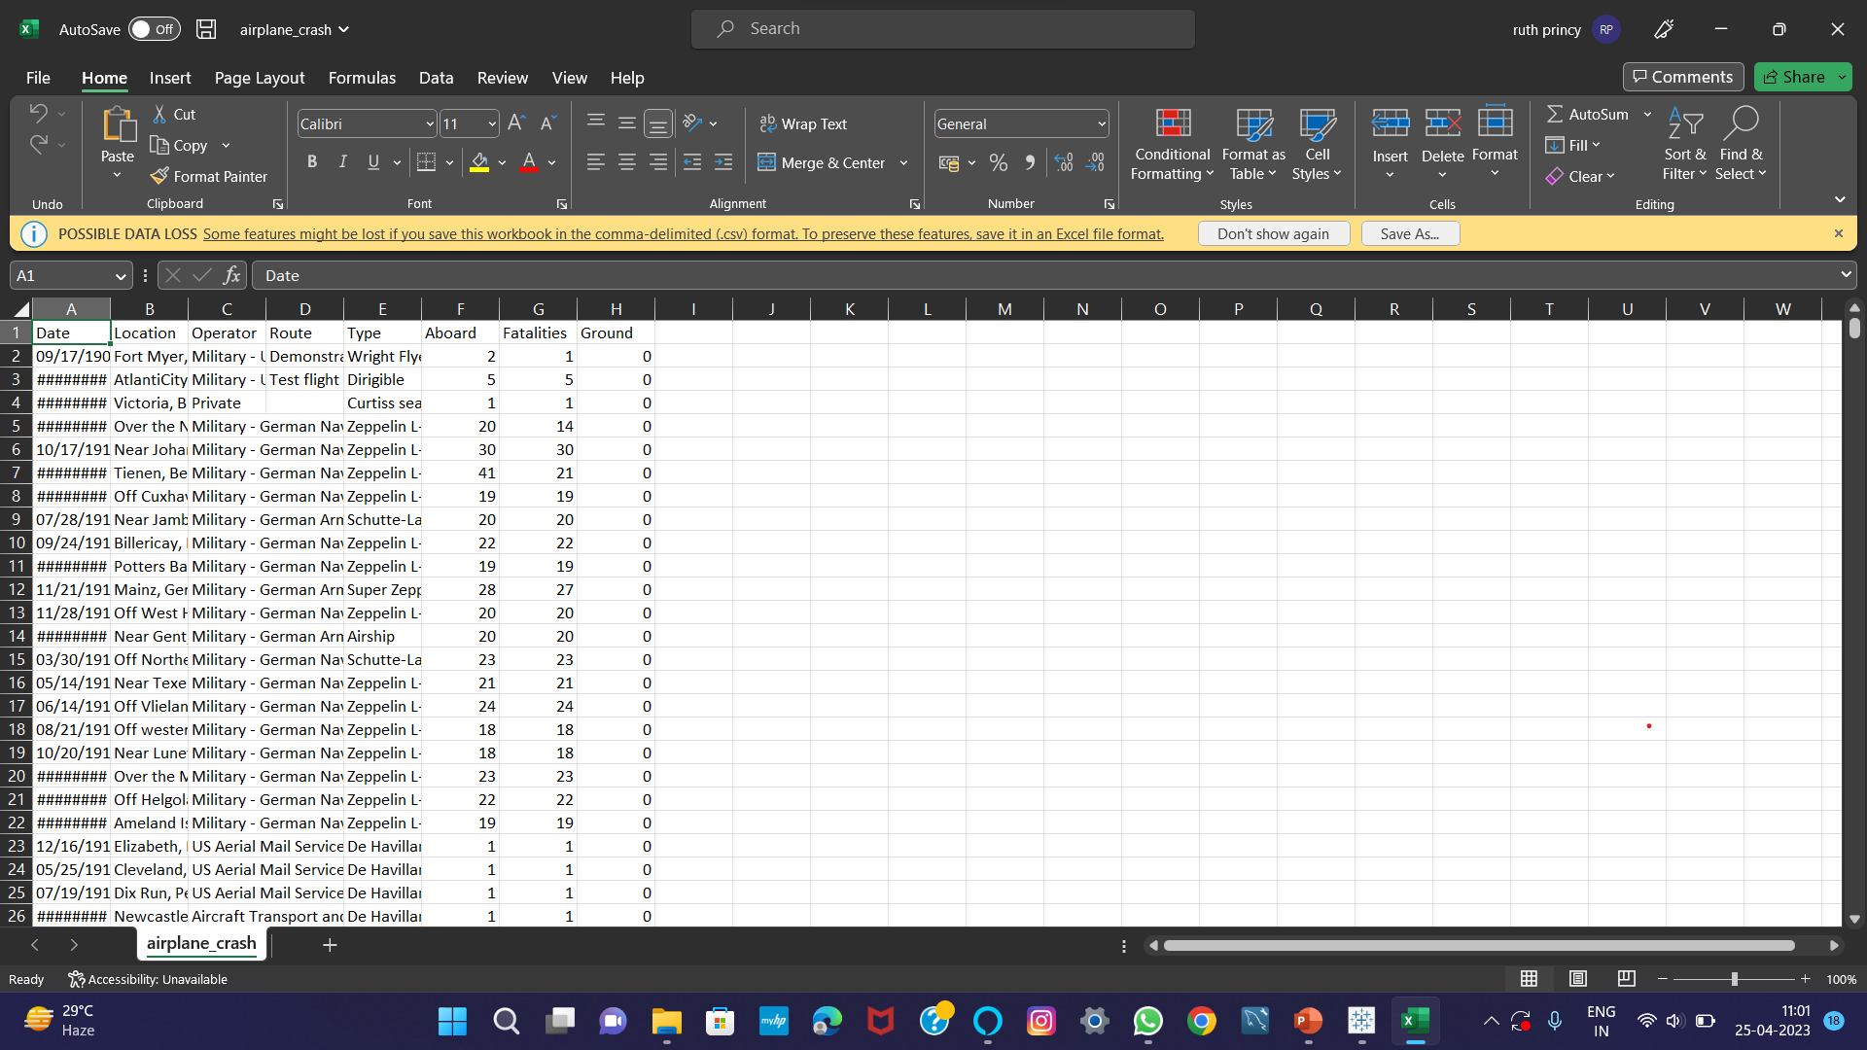

Slide 5
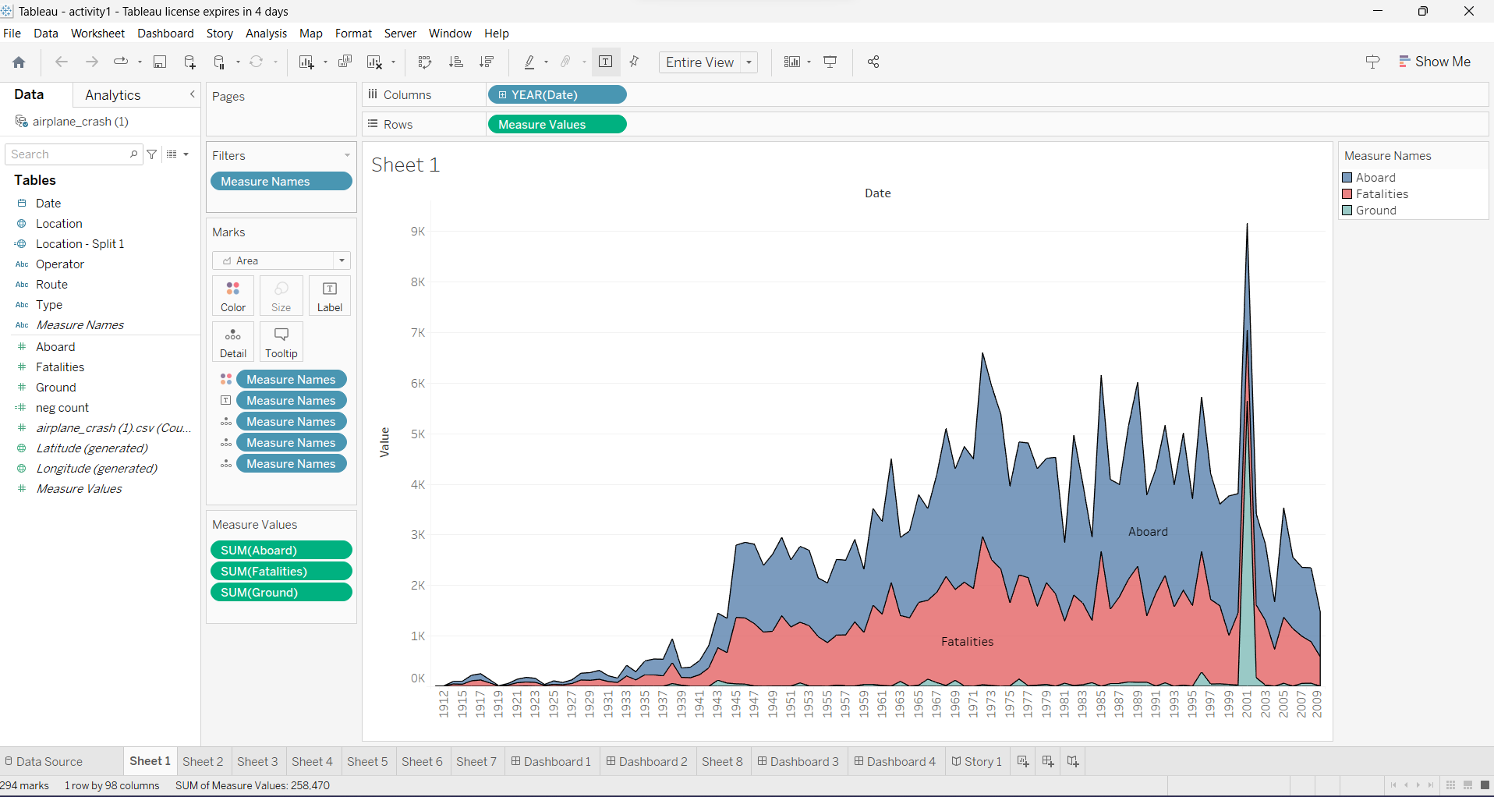

Slide 6
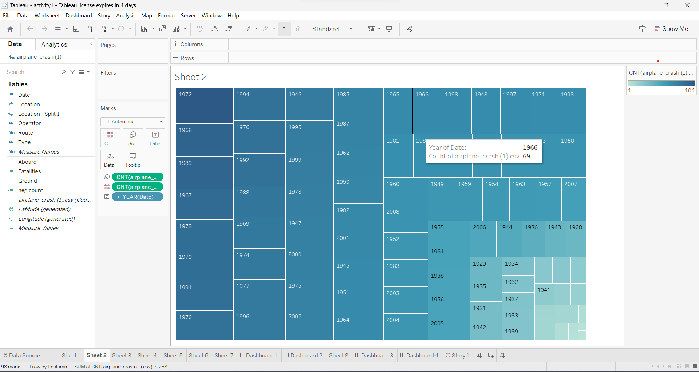

Slide 7
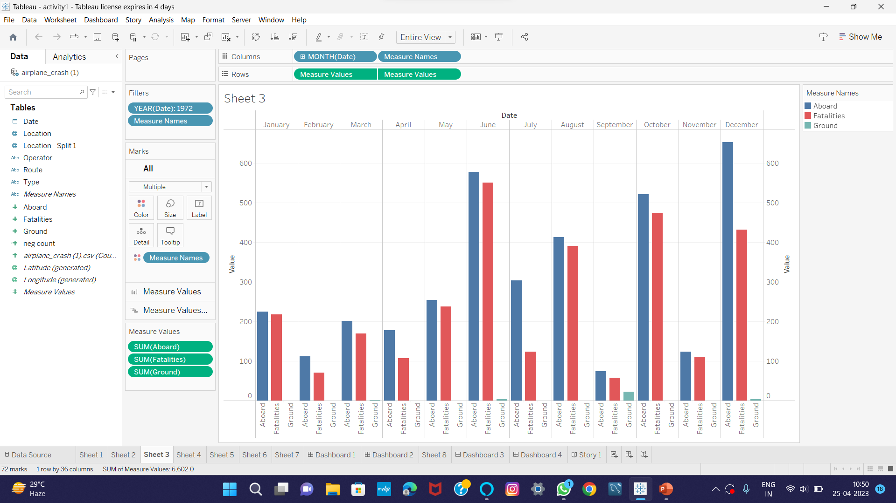

Slide 8
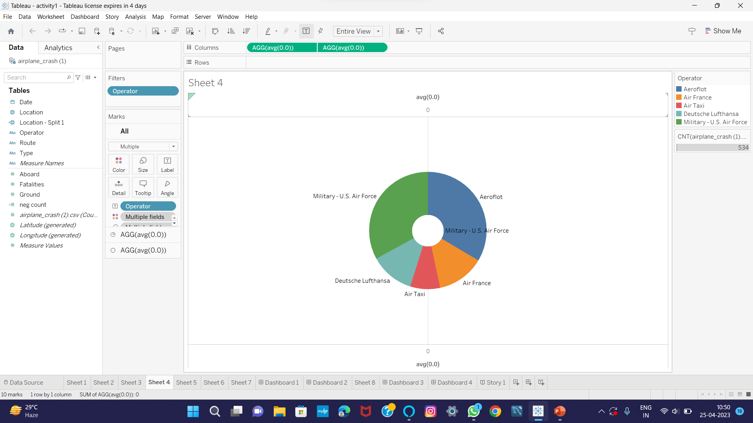

Slide 9
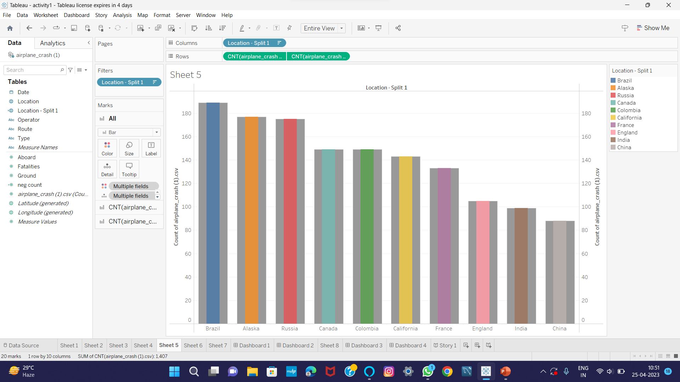

Slide 10
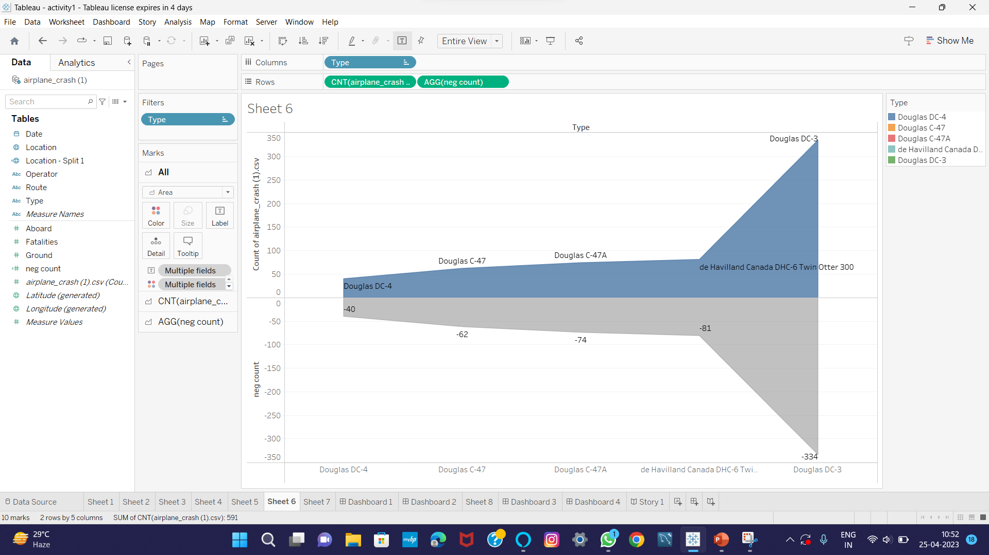

Slide 11
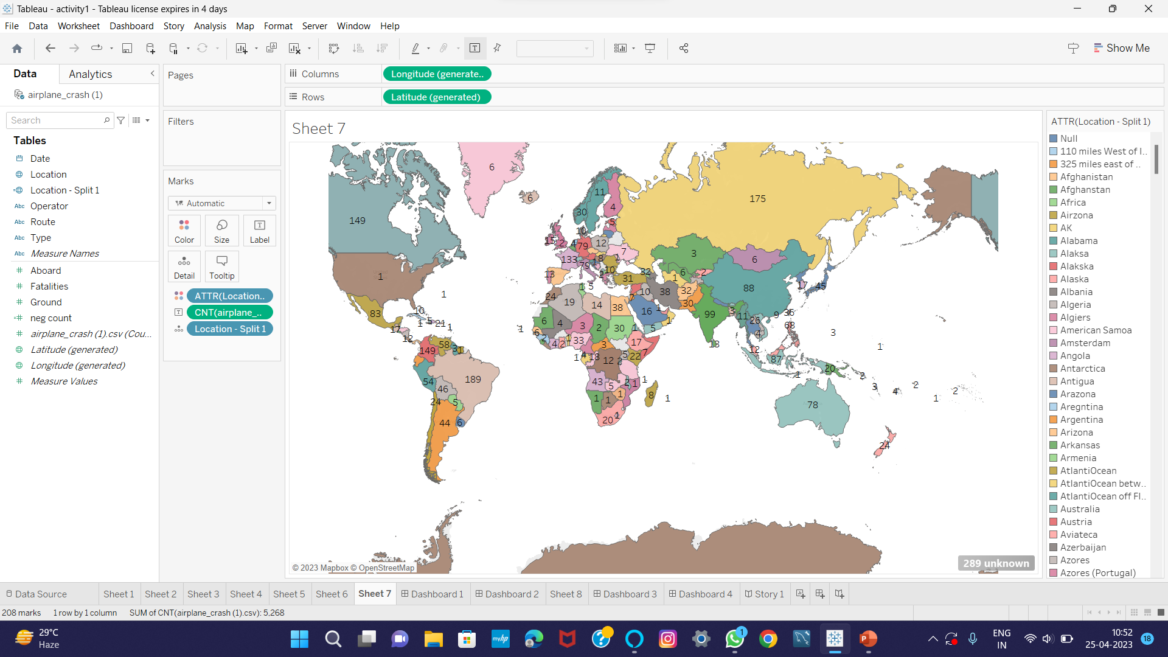

Slide 12
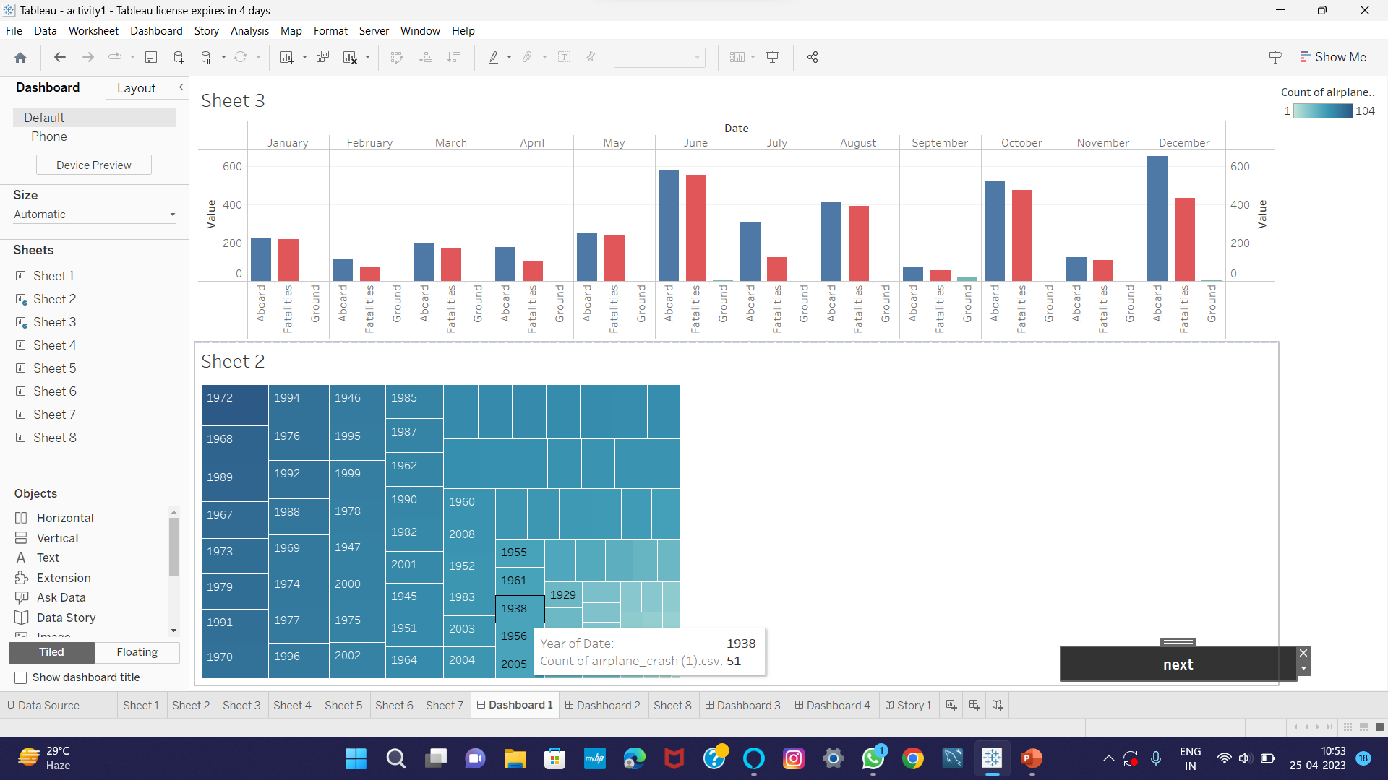

Slide 13
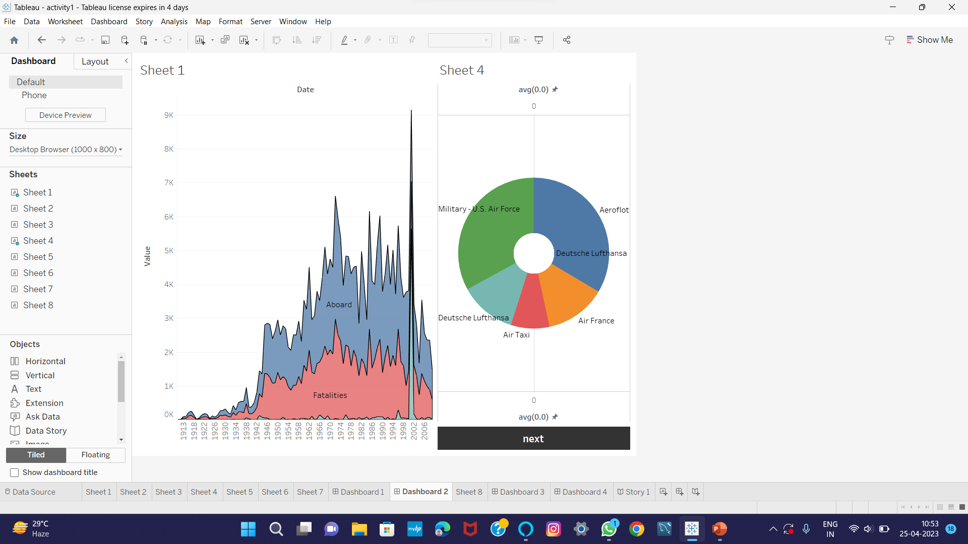

Slide 14
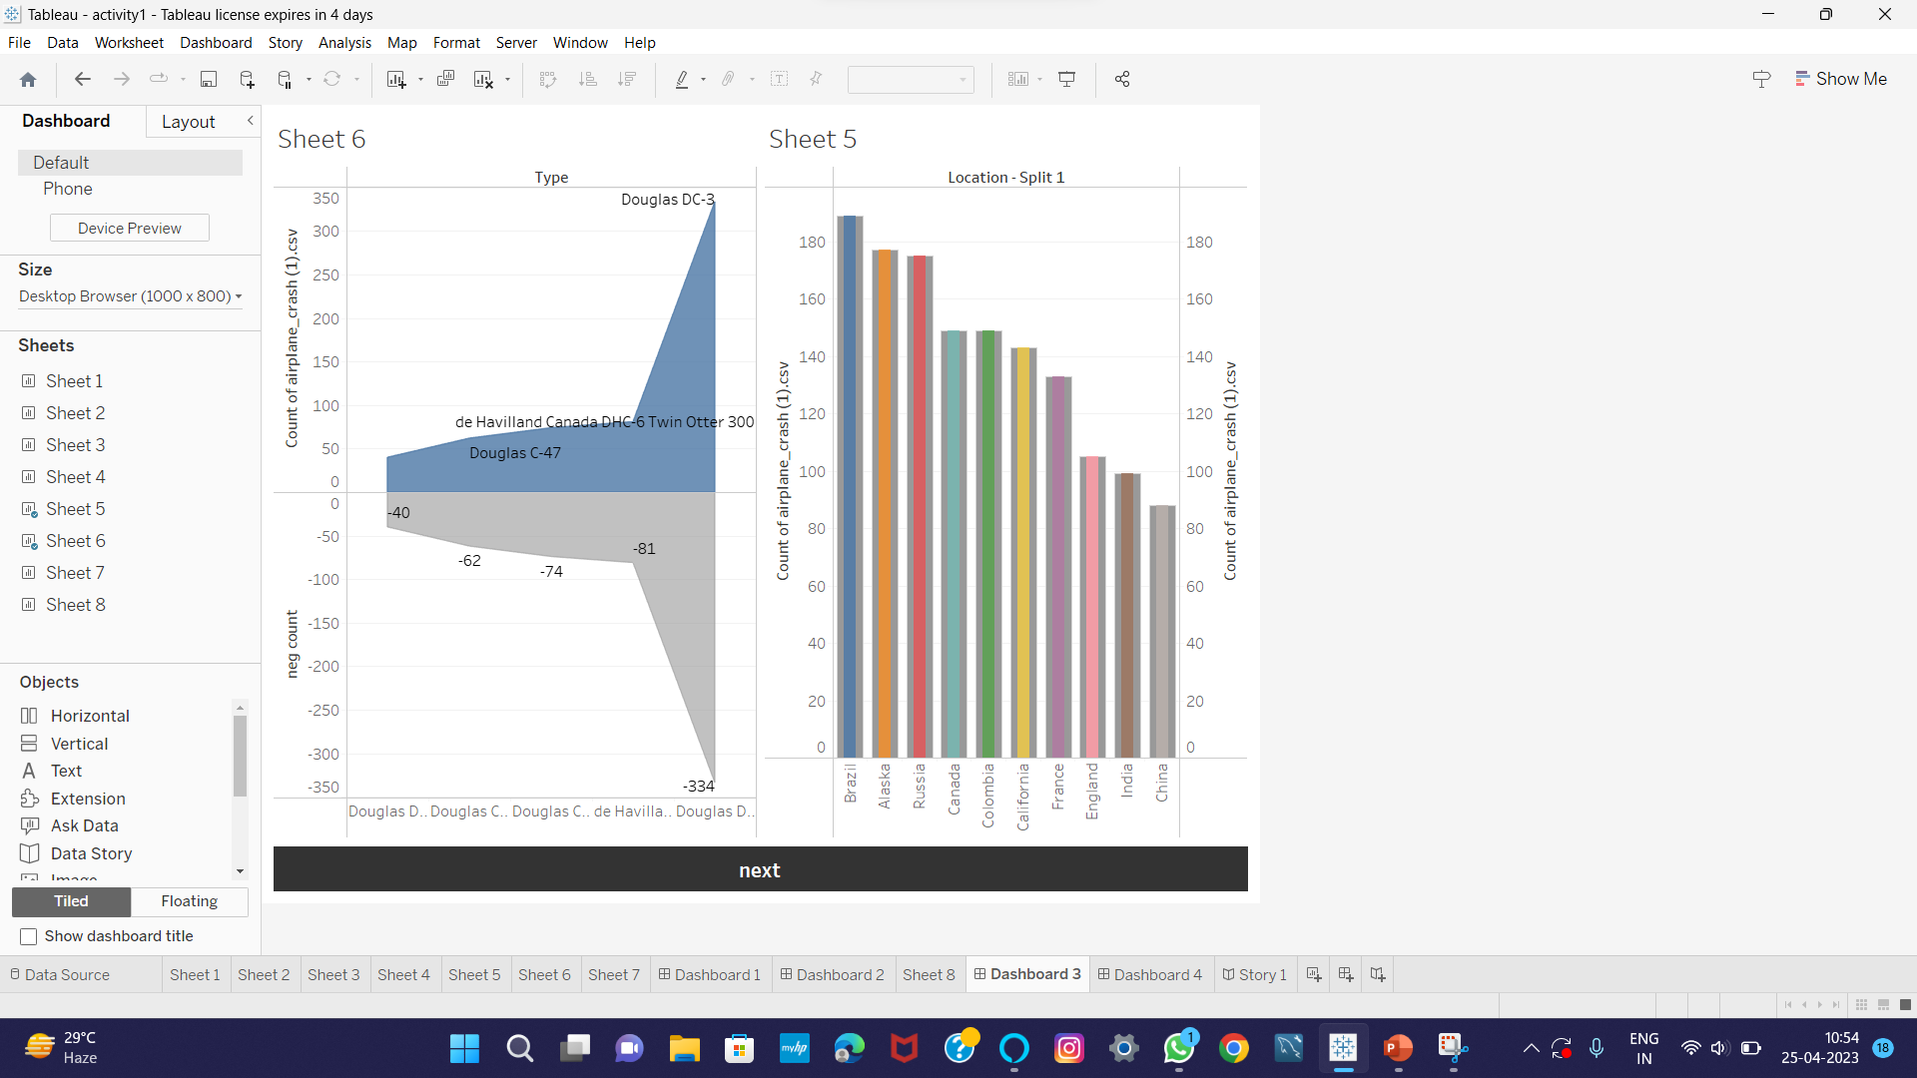

Slide 15
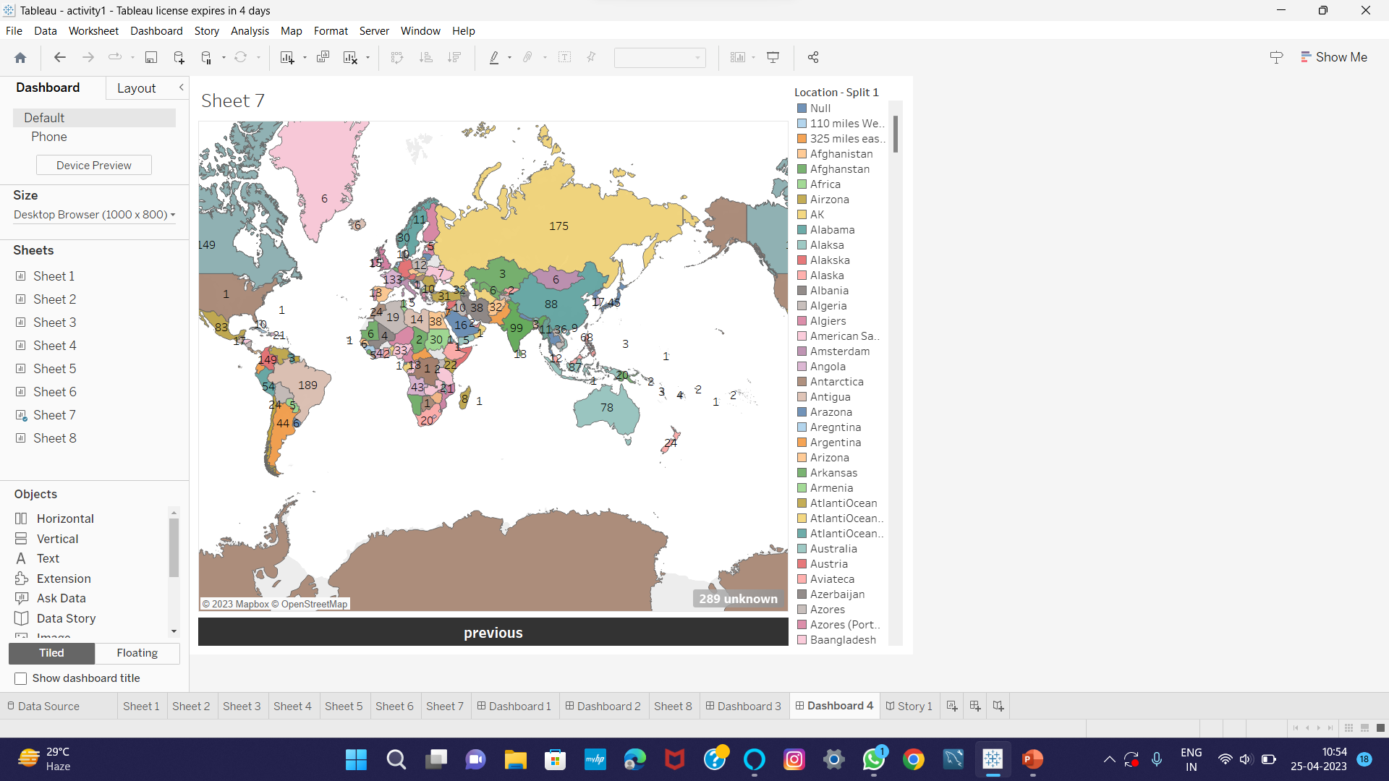

Slide 16
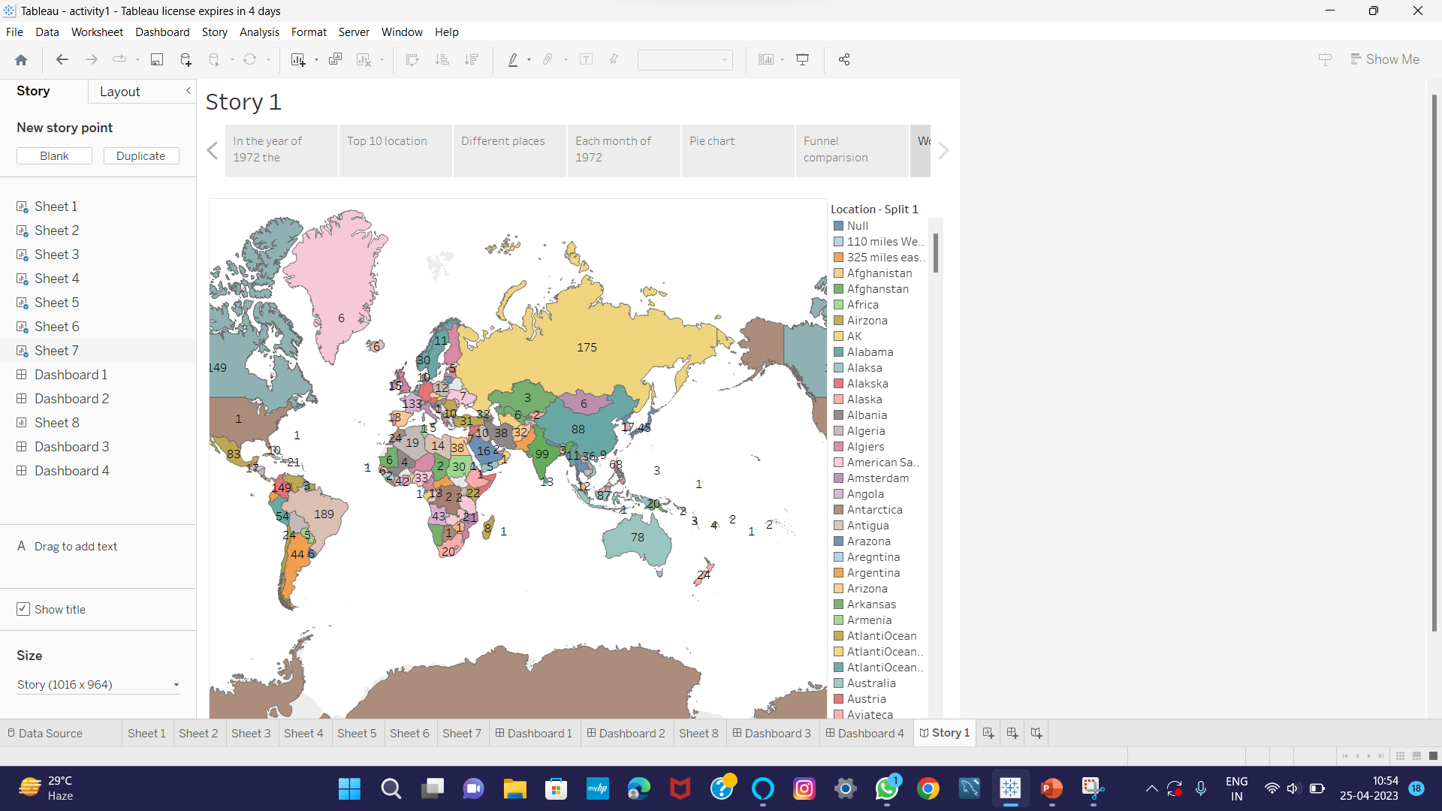

Slide 17
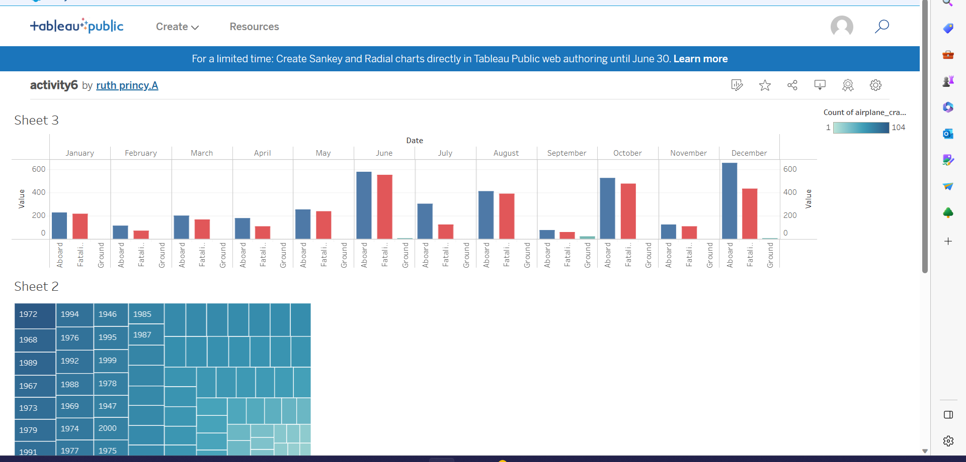
C.Hema Epsipa

Slide 18
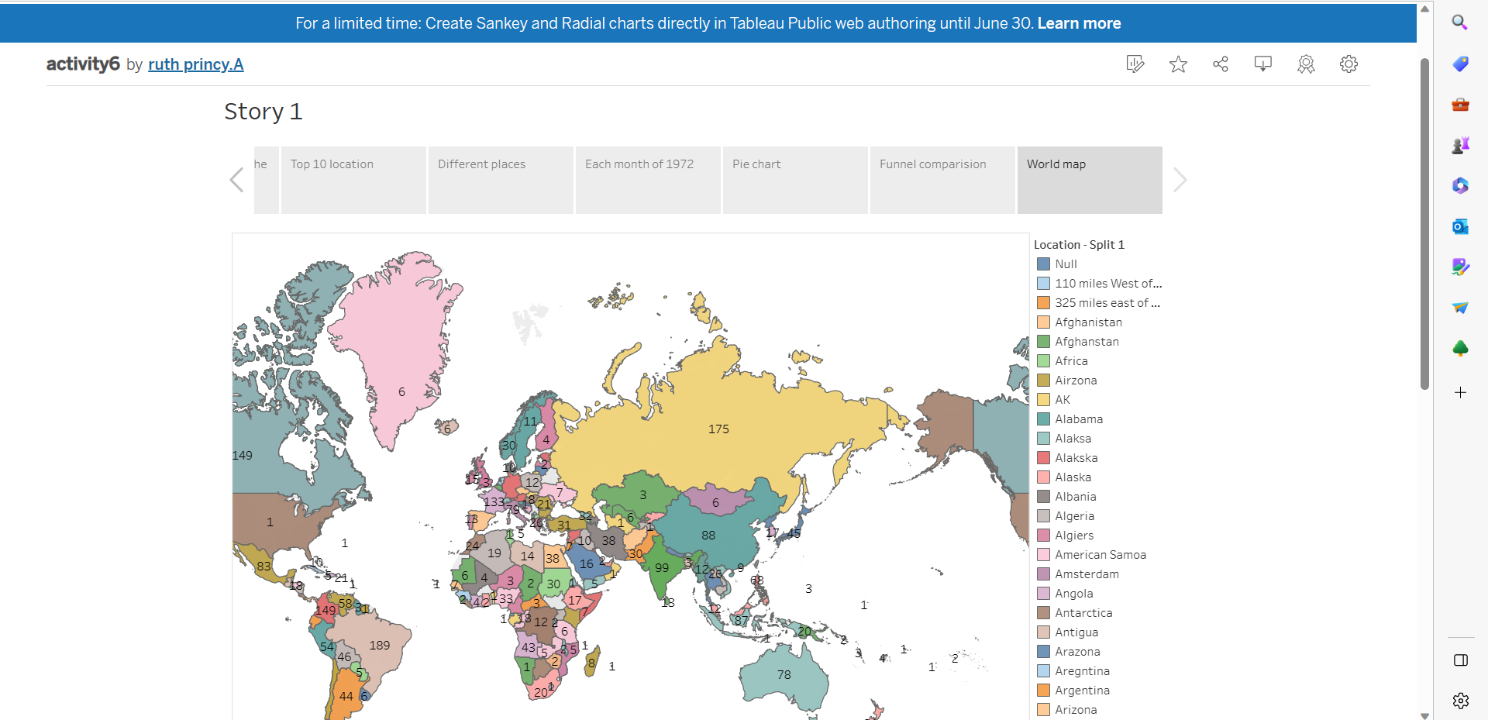
C. Hema Epsipa

Slide 19
THANK YOU

